Slide 1




GridWorld
© A+ Computer Science - www.apluscompsci.com

Slide 2
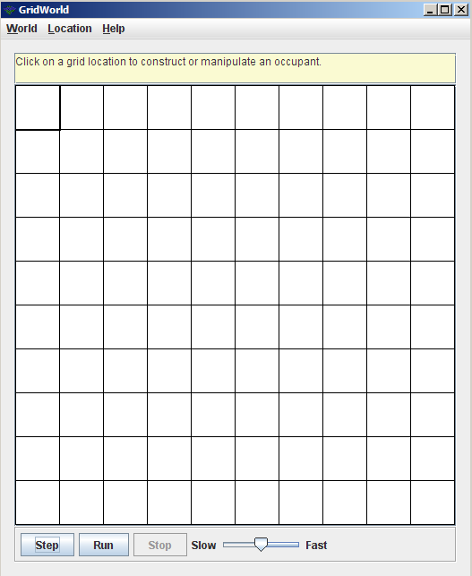
What is GridWorld?
Row = 0
Column = 0
© A+ Computer Science - www.apluscompsci.com
Notes:
A grid is a structure that has rows and columns.
A spreadsheet is a grid.
A checker board is a grid.

Slide 3
What is GridWorld?
cols
rows
A grid is a structure that has rows and columns.
© A+ Computer Science - www.apluscompsci.com
Notes:
A grid is a structure that has rows and columns.
A spreadsheet is a grid.
A checker board is a grid.

Slide 4
What is GridWorld?
Row = 2
Column = 1
© A+ Computer Science - www.apluscompsci.com
Notes:
A grid is a structure that has rows and columns.
A spreadsheet is a grid.
A checker board is a grid.

Slide 5
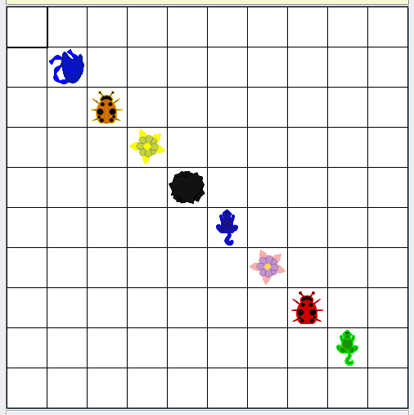
What is GridWorld?
© A+ Computer Science - www.apluscompsci.com

Slide 6
Location
© A+ Computer Science - www.apluscompsci.com

Slide 7
Location frequently used methods
Name | Use
Location(row, col) | creates a new row,col Location
getCol() | gets the column value for this location
getRow() | gets the row value for this location
import info.gridworld.grid.Location;
© A+ Computer Science - www.apluscompsci.com

Slide 8
Location
Location locTwo = new Location(3,5);
System.out.println(locTwo);
System.out.println(locTwo.getRow());
System.out.println(locTwo.getCol());
OUTPUT
(3, 5)
3
5
The Location class stores row and column information.
© A+ Computer Science - www.apluscompsci.com
Notes:
Location is a class that stores row and column information.
Location spot = new Location(4,5);
spot has a row value of 4 and a column value of 5.

Slide 9
Location
reference variable
Location theLoc = new Location(3,4);
object instantiation
© A+ Computer Science - www.apluscompsci.com
Notes:
Location is a class which must be instantiated before it can be used. In other words, you must make a new Location if you want to use a Location. A reference must be used to store the location in memory of the Location object created.
A row value and a column value must be passed as parameters to the Location constructor.
theLoc is a reference that will store the location/memory address of newly created Location object.

Slide 10

Location
reference
command / method
theLoc.getRow();
© A+ Computer Science - www.apluscompsci.com

Slide 11
open
locationone.java
© A+ Computer Science - www.apluscompsci.com

Slide 12
Location frequently used fields
Name | Use
NORTH | indicates going north – value of 0
SOUTH | indicates going south – value of 180
EAST | indicates going east – value of 90
WEST | indicates going west – value of 270
import info.gridworld.grid.Location;
© A+ Computer Science - www.apluscompsci.com
Notes:
The location class contains the following 8 directions :
Location.NORTH
Location.SOUTH
Location.EAST
Location.WEST
Location.NORTHWEST
Location.SOUTHWEST
Location.NORTHEAST
Location.NORTHWEST
All of the direction fields in the location class are final integers.

Slide 13
Location
NORTH - 0
Dude
WEST - 270
EAST - 90
SOUTH - 180
© A+ Computer Science - www.apluscompsci.com
Notes:
The location class contains the following 8 directions :
Location.NORTH
Location.SOUTH
Location.EAST
Location.WEST
Location.NORTHWEST
Location.SOUTHWEST
Location.NORTHEAST
Location.NORTHWEST
All of the direction fields in the location class are final integers.

Slide 14
Location
System.out.println(Location.NORTH);
System.out.println(Location.SOUTH);
System.out.println(Location.EAST);
System.out.println(Location.WEST);
OUTPUT
0
180
90
270
© A+ Computer Science - www.apluscompsci.com
Notes:
The location class contains the following 8 directions :
Location.NORTH
Location.SOUTH
Location.EAST
Location.WEST
Location.NORTHWEST
Location.SOUTHWEST
Location.NORTHEAST
Location.NORTHWEST
All of the direction fields in the location class are final integers.

Slide 15
open
locationtwo.java
© A+ Computer Science - www.apluscompsci.com

Slide 16
Location frequently used methods
Name | Use
getAdjacentLocation(dir) | get nearest loc in the dir
getDirectionToward(dest) | gives dir needed to reach dest
compareTo(thang) | compares this to thang
equals(thang) | test equality of this and thang
import info.gridworld.grid.Location;
© A+ Computer Science - www.apluscompsci.com

Slide 17
Location
Location locOne = new Location(2,1);
Location locTwo = new Location(1,3);
out.println(locOne.getAdjacentLocation(Location.NORTH));
out.println(locOne.getAdjacentLocation(Location.SOUTH));
out.println(locOne.getAdjacentLocation(Location.EAST));
out.println(locOne.getAdjacentLocation(Location.WEST));
out.println(locOne.getDirectionToward(locTwo));
OUTPUT
(1, 1)
(3, 1)
(2, 2)
(2, 0)
45
0,0 | 0,1 | 0,2 | 0,3 | 0,4
1,0 | 1,1 | 1,2 | 1,3 | 1,4
2,0 | 2,1 | 2,2 | 2,3 | 2,4
3,0 | 3,1 | 3,2 | 3,3 | 3,4
© A+ Computer Science - www.apluscompsci.com
Notes:
getAdjacentLocation will return a nearby location based on a provided direction.
getDirectionToward will look at two locations and return the direction required to go from a to b.

Slide 18
open
locationthree.java
© A+ Computer Science - www.apluscompsci.com

Slide 19
Location
Location locOne = new Location(9,1);
Location locTwo = new Location(3,6);
System.out.println(locOne.equals(locTwo));
System.out.println(locOne.compareTo(locTwo));
System.out.println(locTwo.compareTo(locOne));
OUTPUT
false
1
-1
© A+ Computer Science - www.apluscompsci.com
Notes:
The equals method compares two locations to see if both have the same row and column values.
The compareTo method compares two locations for equality, greater than, and less than.
If A>B, compareTo returns a value >0.
If A<B, compareTo returns a value <0;
If A==B, compareTo returns 0.
When comparing locations, compareTo first compares the row value. If the row values are the same, the column value is compared.

Slide 20
open
locationfour.java
© A+ Computer Science - www.apluscompsci.com

Slide 21
Actor
© A+ Computer Science - www.apluscompsci.com

Slide 22

Actor
Actor is the basic object from which all other GridWorld actors will be built.
Each of the new actors created will extend the original actor class.
© A+ Computer Science - www.apluscompsci.com

Slide 23
Actor frequently used methods
Name | Use
Actor() | creates new blue north bound actor
act() | reverses the direction for actor
getColor() | gets the actor’s color
getDirection() | gets the actor’s direction
getLocation() | gets the actor’s location
setColor(col) | sets the actor’s color to col
setDirection(dir) | sets the actor’s direction to dir
moveTo(loc) | moves the actor to new location loc
© A+ Computer Science - www.apluscompsci.com
Notes:
Notice that actor has only one constructor and that that constructor takes no parameters.

Slide 24
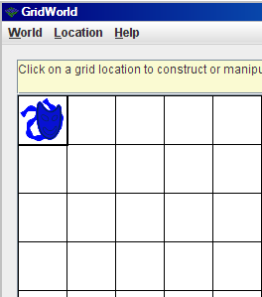
Actor
ActorWorld world = new ActorWorld();
Actor dude = new Actor();
world.add(new Location(0,0), dude);
world.show();
What happens if you click
on the actor?
© A+ Computer Science - www.apluscompsci.com
Notes:
The add method of class world receives a location parameter and an actor.
The actor reference is stored in the grid at the specified location.
The default color of an actor is BLUE.

Slide 25
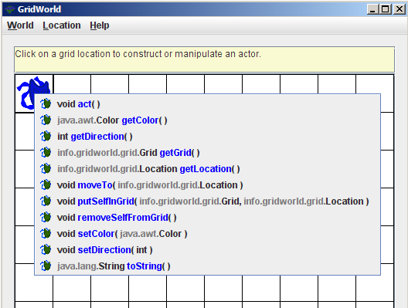
Actor
When you click on an actor, a list of methods is shown.
© A+ Computer Science - www.apluscompsci.com

Slide 26
open
actorone.java
© A+ Computer Science - www.apluscompsci.com

Slide 27
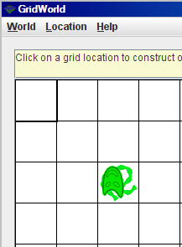
Actor
ActorWorld world = new ActorWorld();
Actor dude = new Actor();
dude.setColor(Color.GREEN);
dude.setDirection(Location.SOUTH);
Location loc = new Location(2,2);
world.add(loc, dude);
world.show();
What happens if you click on an empty location?
© A+ Computer Science - www.apluscompsci.com
Notes:
If you want an actor have a color other than BLUE, simply call the setColor method and provide the color of your choice.

Slide 28
open
actortwo.java
© A+ Computer Science - www.apluscompsci.com

Slide 29
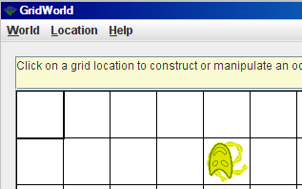
Actor
What does an Actor do when its act() method is called ?
How does the act() method get called?
© A+ Computer Science - www.apluscompsci.com
Notes:
An actor does not move from cell to cell, but it does flip from side to side within its cell.
An actor’s act method is called when the step or run button is called.
The act method contains the code that determines the behavior for each type of actor.

Slide 30
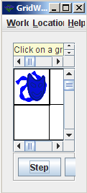
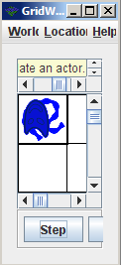
act
The actor act method calls methods to make the actor do something.
Each time the act method
for the default actor is
called, the actor changes
to the opposite direction.
© A+ Computer Science - www.apluscompsci.com
Notes:
An actor does not move from cell to cell, but it does flip from side to side within its cell.
An actor’s act method is called when the step or run button is called.
The act method contains the code that determines the behavior for each type of actor.
The act method will be overridden when new types of actors are created.

Slide 31
moveTo
The moveTo method is essentially a setLocation method.
The moveTo method is used to make an actor move to a new location.
chucky.moveTo(new Location(3,3));
© A+ Computer Science - www.apluscompsci.com
Notes:
The actor moveTo method can be used to move an actor to another location.
The actor moveTo method functions like a setLocation method.
Actor does not have a setLocation method.

Slide 32
Actor
ActorWorld world = new ActorWorld();
Actor dude = new Actor();
dude.setColor(Color.ORANGE);
dude.setDirection(Location.WEST);
world.add(new Location(1,2), dude);
dude.moveTo(new Location(6,7));
dude.moveTo(new Location(8,7));
world.show();
Where does dude show up?
© A+ Computer Science - www.apluscompsci.com
Notes:
You can place an actor in the grid at a specified location and then that actor’s location may change as the program runs.
You can also place the actor in the grid in the main and then for testing and understanding, change the location with code statements to see the effect.
For the code above, the actor will appear at position 8,7. The actor had an initial location of 1,2 that was changed to 6,7 and then finally set as 8,7.

Slide 33
open
actorthree.java
© A+ Computer Science - www.apluscompsci.com

Slide 34
Extending
Actor
© A+ Computer Science - www.apluscompsci.com

Slide 35
Extending Actor
To make a new actor, you must
extend the Actor class and override the act method to give the new actor its own unique behavior.
What would have to be done to make a new actor that only moved to the right?
© A+ Computer Science - www.apluscompsci.com
Notes:
When extending actor, the act method will most always be overridden to create some new type of actor with new behaviors.

Slide 36
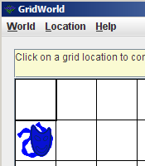
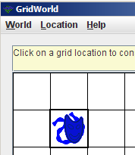
Extending Actor
public class SideWaysActor extends Actor
{
public void act()
{
//move to the right
}
}
© A+ Computer Science - www.apluscompsci.com
Notes:
When extending actor, the act method will most always be overridden to create some new type of actor with new behaviors.

Slide 37
open
sidewaysactor.java
sidewaysactorrunner.java
© A+ Computer Science - www.apluscompsci.com

Slide 38
Start work
on Actor Labs
© A+ Computer Science - www.apluscompsci.com

Slide 39
Actor frequently used methods
Name | Use
putSelfInGrid(grid, loc) | put this actor in grid at loc
removeSelfFromGrid() | takes this actor out of the grid
getGrid() | gets the grid which contains this actor
toString() | gets actor data as a String
import info.gridworld.actor.Actor;
© A+ Computer Science - www.apluscompsci.com

Slide 40
putSelfInGrid
The putSelfInGrid method puts an actor into a grid at a specified location.
The world add method calls putSelfInGrid when adding an actor to the grid.
world.add(loc, chucky);
chucky.putSelfInGrid(grid, loc);
© A+ Computer Science - www.apluscompsci.com
Notes:
When placing an actor in the grid, the world add method or actor putSelfInGrid method must be called.
The world add method calls the actor putSelfInGrid method automatically.

Slide 41
removeSelfFromGrid
The removeSelfFromGrid method removes an actor from its grid.
When it is time to do away with an actor, call removeSelfFromGrid and the actor will disappear.
chucky.removeSelfFromGrid();
© A+ Computer Science - www.apluscompsci.com
Notes:
The removeSelfFromGrid is useful to remove an actor from a grid.

Slide 42
Actor
ActorWorld world = new ActorWorld();
Actor dude = new Actor();
dude.setColor(Color.YELLOW);
dude.setDirection(Location.SOUTH);
Location loc = new Location(1,4);
dude.putSelfInGrid(world.getGrid(),loc);
world.show();
What happens when you hit the run button?
© A+ Computer Science - www.apluscompsci.com
Notes:
When placing an actor in the grid, the world add method or actor putSelfInGrid method must be called.
The world add method calls the actor putSelfInGrid method automatically.

Slide 43
open
actorfour.java
© A+ Computer Science - www.apluscompsci.com

Slide 44
Grid
All of the actors are stored in a grid. A grid has rows and columns.
cols
0 | 0 | 0 | 0 | 0
0 | 0 | 0 | 0 | 0
0 | 0 | 0 | 0 | 0
0 | 0 | 0 | 0 | 0
0 | 0 | 0 | 0 | 0
rows
© A+ Computer Science - www.apluscompsci.com
Notes:
Grid is a row / column structure that stores Objects.
The location of each Object is determined by the Location provided when putting the Object in the grid.

Slide 45
Grid
World is used to
show the grid
graphically.
© A+ Computer Science - www.apluscompsci.com
Notes:
World stores the grid of Objects.
World is a graphical environment that displays the grid and its contents graphically.

Slide 46
Grid frequently used methods
Name | Use
get(loc) | returns the object at location loc
getNumCols() | gets the # of cols for this grid
getNumRows() | gets the # of rows for this grid
isValid(loc) | checks to see if loc is valid
put(loc, obj) | put the obj in grid at location loc
remove(loc) | take the obj at location loc out of the grid
import info.gridworld.grid.Grid;
© A+ Computer Science - www.apluscompsci.com

Slide 47
getGrid
The getGrid method returns the grid housing this actor.
Grid<Actor> grid = chucky.getGrid();
© A+ Computer Science - www.apluscompsci.com
Notes:
The getGrid method returns a reference to a grid in which this actor is stored.
If you need an actor’s grid, call getGrid.
getGrid will become more useful as new types of actors are created.

Slide 48
open
actorfive.java
© A+ Computer Science - www.apluscompsci.com

Slide 49
Continue work
on Actor Labs
© A+ Computer Science - www.apluscompsci.com

